Slide 1
Research Test: I-Focus
Hwa Chong Institution

Slide 2
Objective
Eye-tracking
Research Application
Website
Game
Intuitiveness, Feasibility, Functionality
Notes:
We are undertaking a school project called I-Focus and it is an eye-tracking project.
The motivation for our project is that everyone is now looking out for new devices and new interaction modes – just look at how we have progressed from a DOS system to the mouse to touchscreens, the Kinect, Google Glasses… Yet all of these input modes are tactile input modes, involving the hands… so we thought what about gaze-interaction, or eye-tracking? Other than costly integrated systems customized for professional or military applications, little is known about using the eye to control an everyday device and this is what we want to explore.
The objective of this research today is to conduct trial testing on 2 platforms: a game and a website, in order to test out the intuitiveness, feasibility and functionality of eye-tracking.

Slide 3
Overview
Part 1: Research test for game (10 min)
Part 2: Research test for website (15-20 min)

Slide 4

Eye-Tracker
Already Setup :)
Calibration
Glasses ok
Possible recalibration
Notes:
Before we go into the objectives for the tasks today, you will have to familiarise yourself with the eye-tracker provided.
The eye-tracker has already been setup for you, but you must perform the calibration.
All you have to do is to look at the white circles once you press “Calibrate” or “Re-calibrate”.
Depending on your calibration result, you may have to perform a re-calibration.
Glasses are ok but you may have to remove it if necessary.

Slide 5
Part 1
Game

Slide 6
Objective (Game)
To determine the best combination of input methods for certain kinds of games

Slide 7
Procedure (Game)
Play 3 games, and do survey (10 min)
Leap Motion Gesture Interaction
Eye-Tracker (Gaze Interaction)
Keyboard
Mouse Keyboard
- Random Order -

Slide 8
Part 2
Website

Slide 9
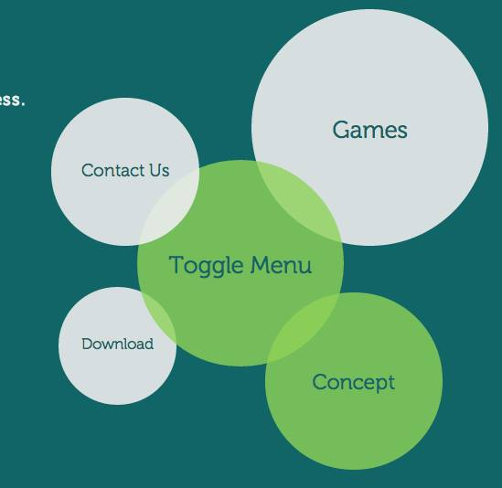
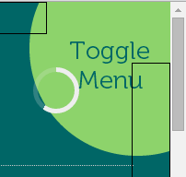
Objectives (Web)
To rate aesthetic & functional design of UI
To compare variety of functions executable by eye gestures or/and other input methods
Menu Arrangement
Radial –vs- linear
Click Triggers
Scrolling methods
Notes:
The objectives for website testing are as follows...
[read slide]

Slide 10
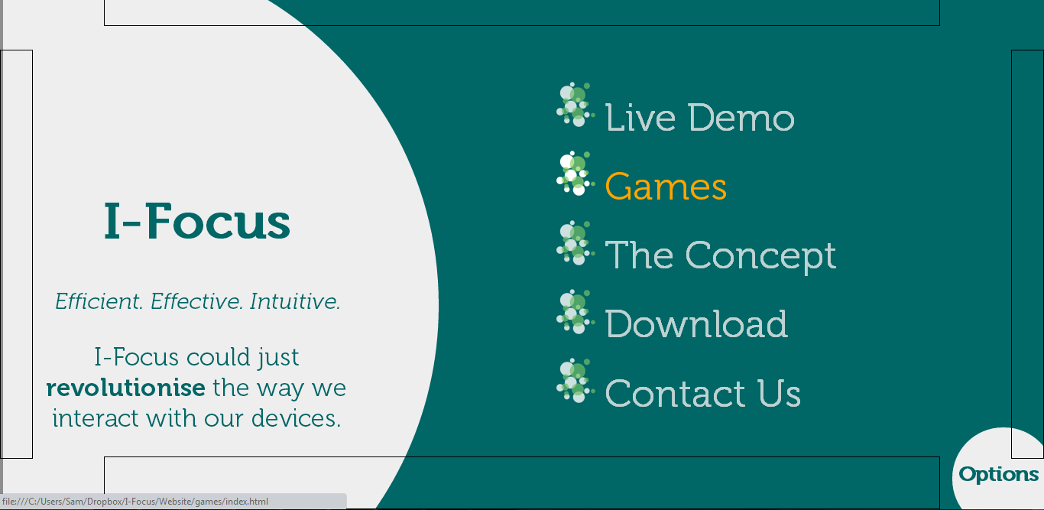
Procedure (Web)
Notes:
Once you have calibrated the eye-tracker and are ready to explore the website, we will be guiding you through the various tasks involved. Apart from navigation, there will be 2 simple comprehension like question which you have to answer as you read through the live demo page.

Slide 11
Procedure (Web)
Version 1 (5 min):
Circular Menu + No physical click + Auto-Scroll
Version 2 (5 min):
Tabbed Menu + Physical click + No Auto-Scroll
Do QUIS (10 min)
Notes:
This will be your schedule for the website testing. Note that the 2 versions may not be necessarily done in order (ie you can do v2 then v1 as well)

Slide 12
Thank you
Happy Testing :D

